Slide 1
North Carolina Innovation Council
Solutions for the Tokenized Economy
Accounting and Income Tax Revenue Examination
2022

Slide 2
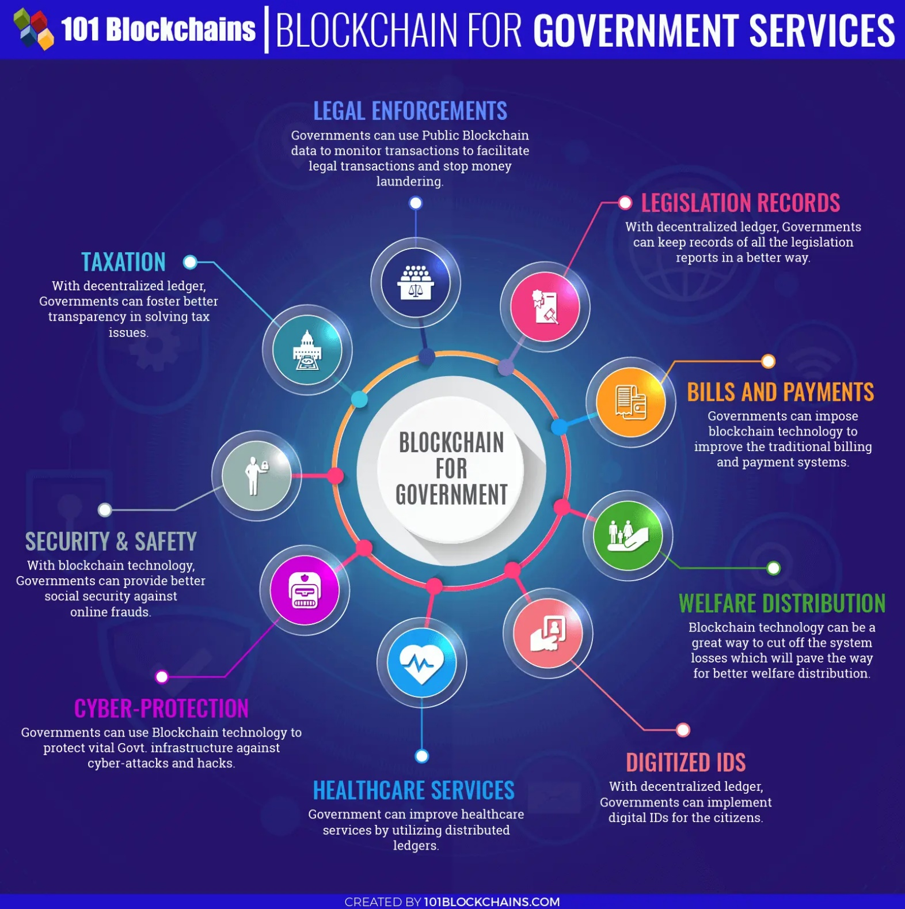

Slide 3
Smart Contracts
Smart contracts are simply programs stored on a blockchain that run when predetermined conditions are met. They typically are used to automate the execution of an agreement so that all participants can be immediately certain of the outcome, without any intermediary’s involvement or time loss. They can also automate a workflow, triggering the next action when conditions are met.
Smart contracts have many use cases including executing trades, enabling lending and borrowing of digital assets against liquidity pools, and minting NFTs, among many others, and are employed heavily on blockchains and in the DeFi space.

Slide 4
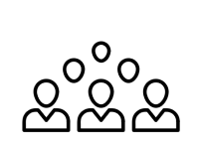
The TaxBit platform connects the tokenized economy
We serve consumers, enterprises, and governments
Government
Enterprise Accounting
Examinations
Forms 8949
Forms 1099
Financial Reports
Consumer
Enterprise Tax
Forms 1099
Ingest
Pull transactions from exchanges, wallets, defi protocols, NFT, etc
Apply accounting and tax policies to transaction data
Provide tax & accounting reports to stakeholders
Deliver data directly into connected platforms (tax / ERP)
Ingest
Calculate
Report
Integrate

Slide 5
Software as a Solution
Software innovations bridging gap between industry innovators and government
First Generation > Centralized
Second Generation >> Decentralized
Providers implementing software solutions that serve to reduce user burden in the digital asset ecosystem
Example: individual tax compliance extremely less burdensome today than it was just three years ago
As new regulations emerge, providers are increasingly prepared with solutions and working with businesses to implement in advance of regulatory deadlines
Example: as tax information reporting regulations land and financial accounting rules evolved, providers are already one-step ahead of regulators on building out the software to handle these new rules and requirements
The debate between regulatory authorities and innovators continues as to “What” regulations should exist and “Who” to regulate
In spite of the continuing conversation, software providers have begun to map out creative solutions as to the “How”
Regardless of where regulatory decisions land, software solutions will need to
play a material role in bridging the gap between regulation and industry innovation
CONFIDENTIAL | 5

Slide 6
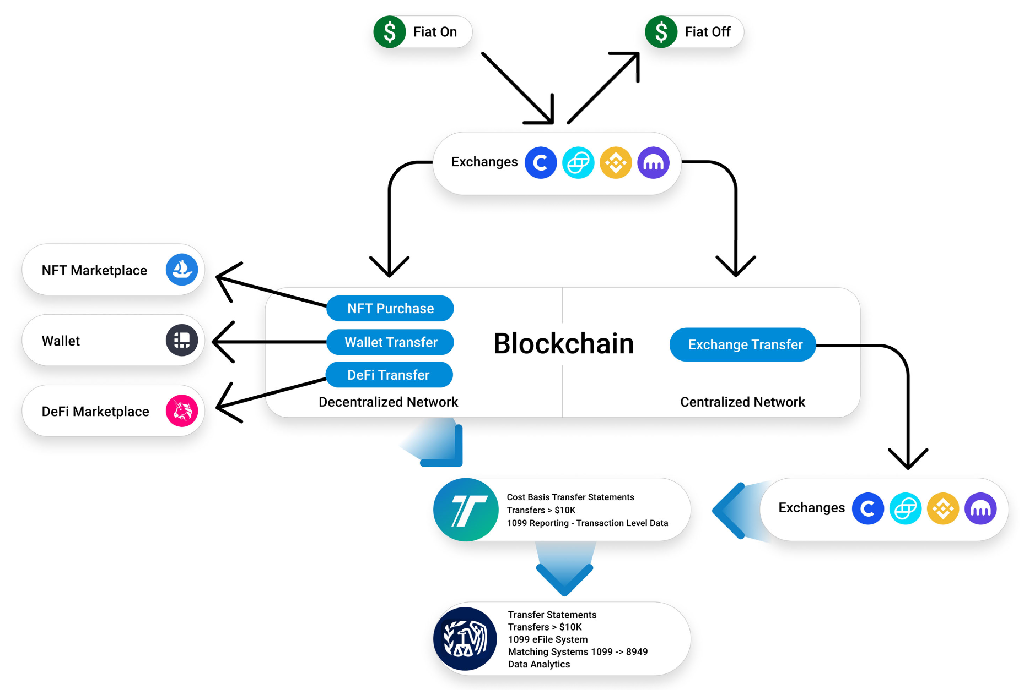
Digital Asset Regulation
A software based approach to regulating the digital asset ecosystem
Software Provider
RA
Regulatory Authorities

Slide 7
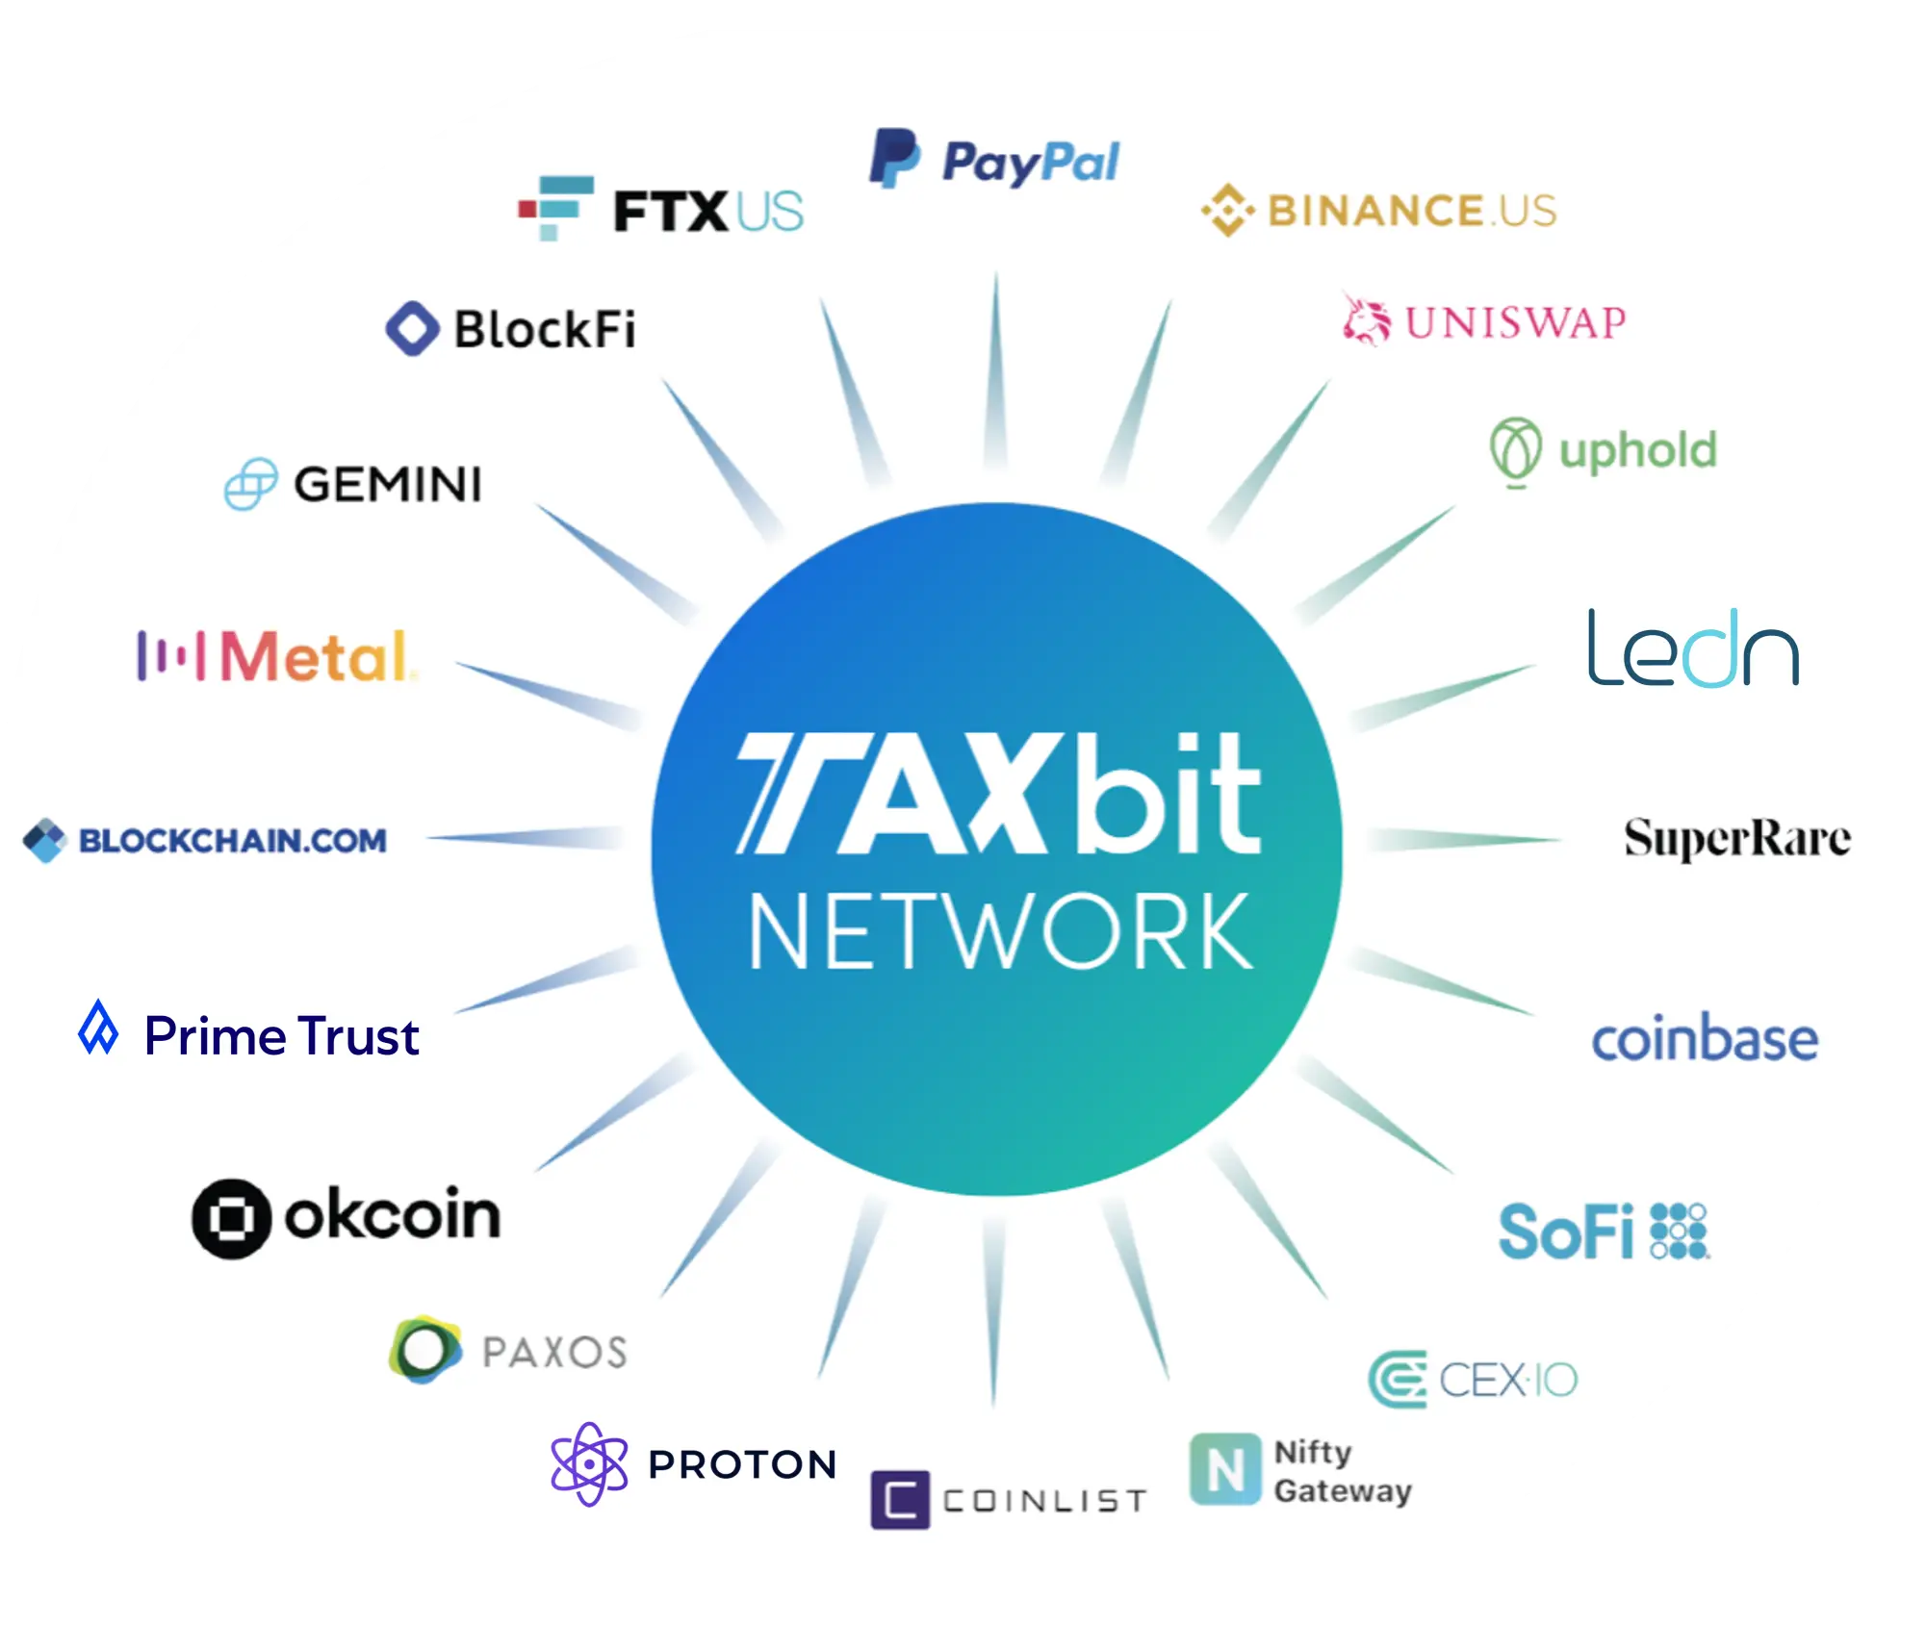
TaxBit Network
Financial Compliance for the Tokenized Economy
TaxBit Network is an industry-wide program for the most reputable digital asset platforms. A single industry standard for cost basis reporting and Transfer Statements to simplify US Infra Bill compliance.
Cost Basis Interchange (CBI) tracks and transfers Cost Basis data Broker-to-Broker in real-time
Trusted 3rd-party to ingest, analyze, and organize all transactional data, provide accurate Cost Basis, and deliver Transfer Statements to the IRS as required
Automated IRS Transfer Statement generation and delivery to IRS for any transactions sent to Non-Broker Addresses
20+ Supported Companies and Exchanges
Most safe, secure option on the market through SOC 1 (Type 1), SOC 2 (Type 2), and ISO 27001 certification (GSA approved seller)
Compliance Simplified
Trust in Accuracy
Save Time & Money
Safe and Secure

Slide 8
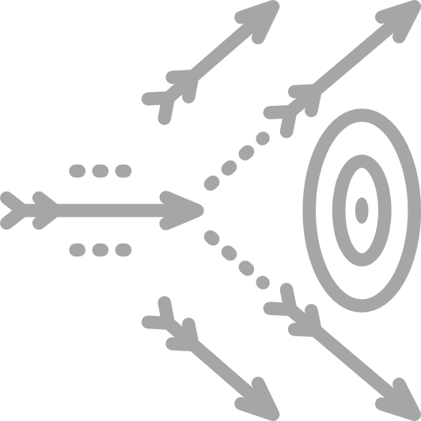
Industry Tax Challenges
Problems
Solutions POWERED BY
Incorrect 1099 issuances
Form 1099-K intended for income receipts, not capital gains and losses
Correct 1099 issuances
Form 1099-B intended for capital assets, reports each taxable transaction and cost basis
Consultancy model
Lack of technology. Dependent on spreadsheets and manual reviews
SaaS model
Automated solution reduces costs and errors and scales with our customers’ business
Tax forms only
Users only learn of taxes due upon receiving a 1099 in January of each year
Full tax center solution
Users engage & transact on embedded Tax Center solution, visibility into real-time tax impacts
Compliance only
No value outside of checking the compliance boxes in order to avoid penalties
Value beyond compliance
Tax optimization and tax loss harvesting serve to drive exchange transaction volume

Slide 9
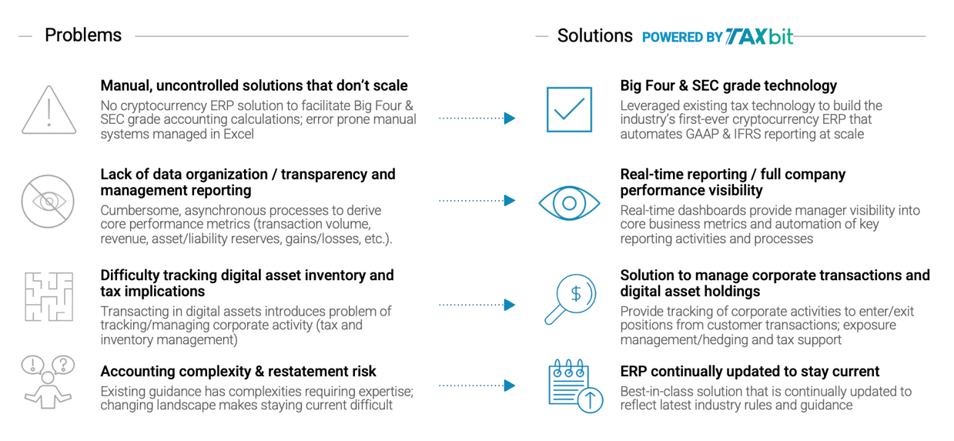
Industry Accounting Challenges

